Slide 1
Emergency response worker
Maths in the workplace

Slide 2
How our teaching resources are designed for the classroom

Slide 3
I can understand how maths is used by emergency response workers.

Slide 4
A formula is a rule linking sets of physical variables in context.
Data are a collection of information.

Slide 5

Emergency response worker
Uses of formulas
Uses of data

Slide 6

Uses of formulas
Formulas are everywhere in our world.
A = bh
We see them in maths
E = mc²
We see them in science
(Einstein’s theory of relativity)
T = 20 × 0.45m + 20
We use them in cooking
(cooking time for a chicken)
Some people believe you can even write a formula for love

Slide 7
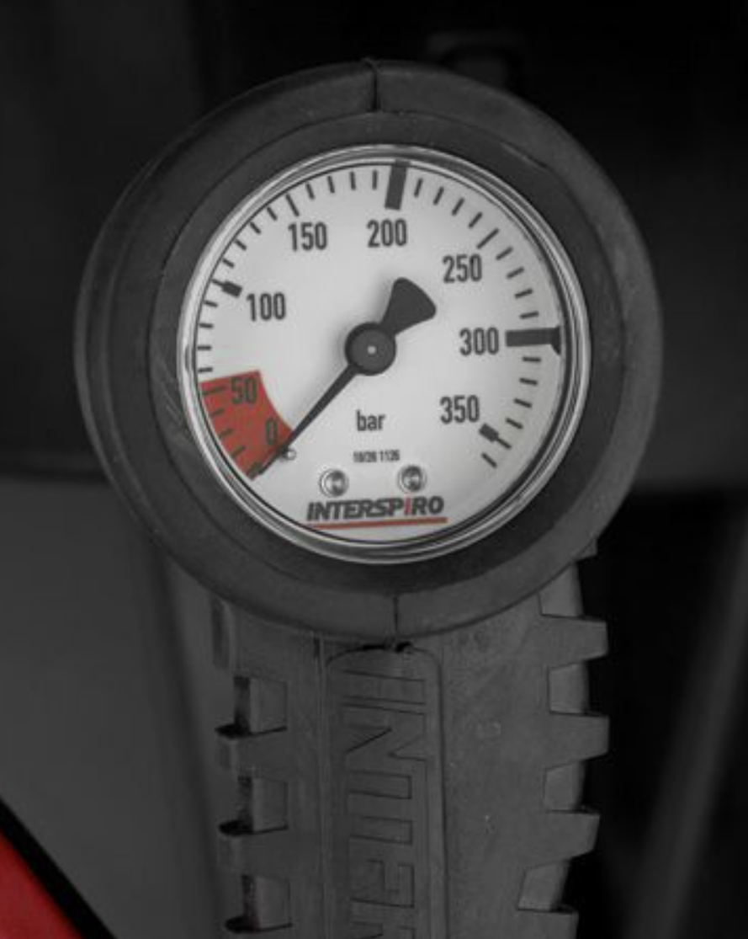
Uses of formulas
Emergency responders use formulas on a daily basis.
This is the gauge of a firefighter’s breathing apparatus.
When a firefighter connects this to their oxygen tank, the gauge tells them how many bar of pressure are left.
In the UK a firefighter must have a minimum 240 bar of pressure in their oxygen tank before they enter a building.

Slide 8
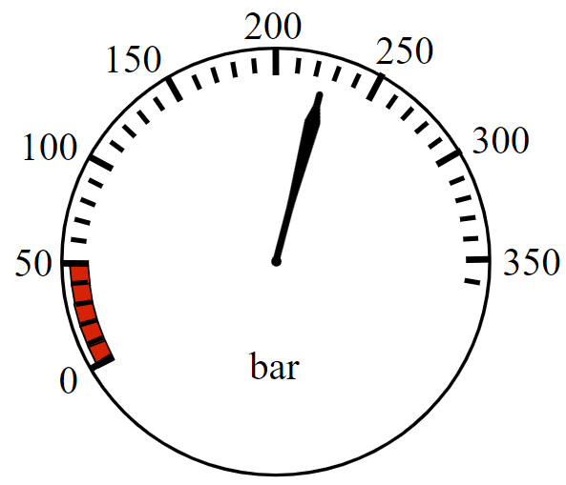
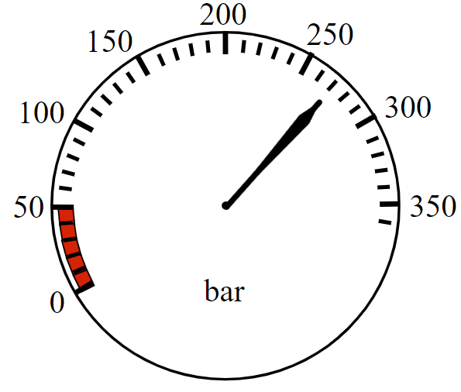
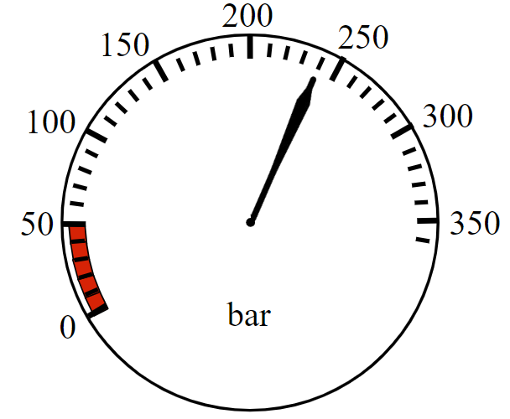



Uses of formulas
In the UK a firefighter must have a minimum 240 bar of pressure in order to enter a building. Which of these tanks can be safely used?
This is the very minimum.
a
b
c

Slide 9
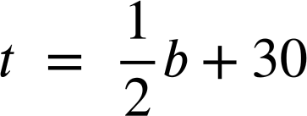
Uses of formulas
Firefighters might enter the building to fight a blaze. They might be entering a large building which has lots of people in it to perform search and rescue during a fire. Before entering they each use a key formula.
The t stands for estimated turn-around pressure.
b is the number of bar of pressure they enter with.

Slide 10
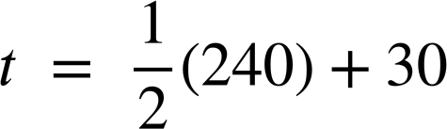
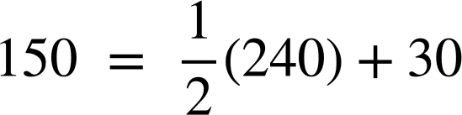
Uses of formulas
The formula calculates when each firefighter must turn around and exit the burning building.
Example, a firefighter entering with 240 bar of pressure…
…will turn around when their pressure gauge reads 150 bar
The t stands for estimated turn-around pressure.
b is the number of bar of pressure they enter with.

Slide 11
Uses of formulas
The formula calculates when each firefighter must turn around and exit the burning building.
Example, a firefighter entering with 240 bar of pressure…
…will turn around when their pressure gauge reads 150 bar
150 bar might sound like a lot of remaining pressure but the firefighter might be deep inside the building and may use a lot of air making their way out. They might even be carrying someone!

Slide 12
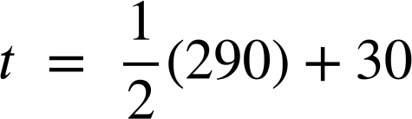
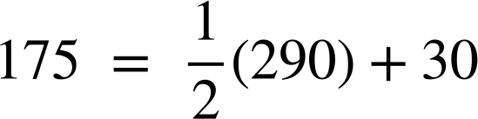
Uses of formulas
At what bar will a firefighter entering with 290 bar turn around?
They will turn around and start to exit when their gauge reads 175 bar

Slide 13
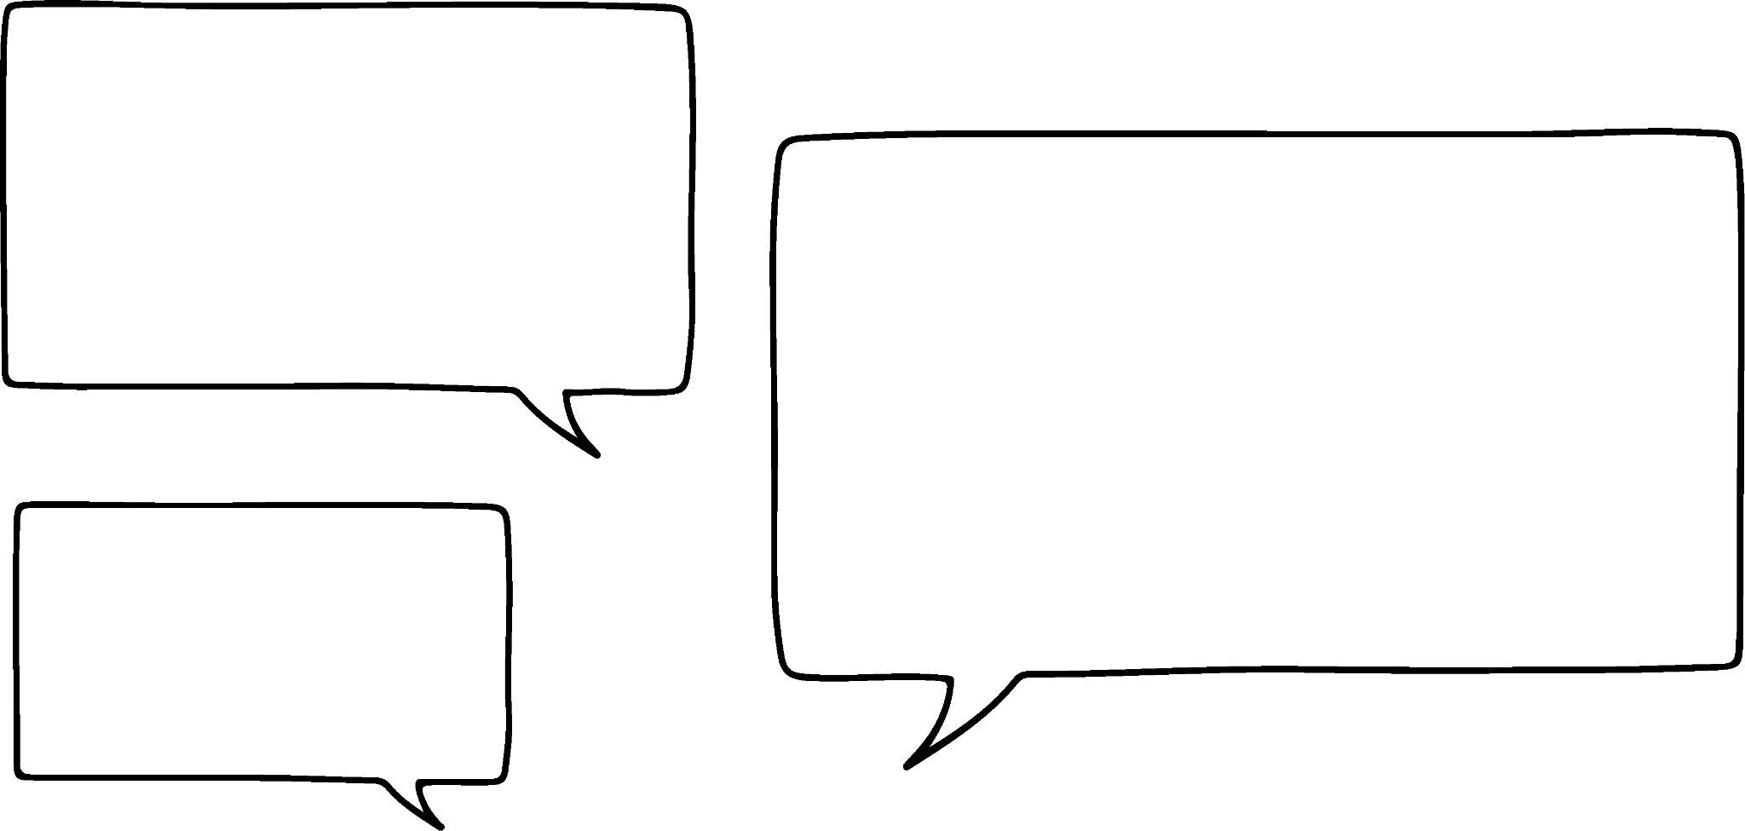

Uses of formulas
Lucas is calculating the estimated turn-around point of a firefighter entering a building with 260 bar
260 + 30 = 290
Half that is 145 so they will turn around after 145 minutes.
Lucas has made at least one error. Spot his errors and explain how he should correct them.

Slide 14
Uses of formulas
Lucas is calculating the estimated turn-around point of a firefighter entering a building with 260 bar
260 + 30 = 290
Half that is 145 so they will turn around after 145 minutes.
You might have said, “Lucas has failed to apply priority of operations. The 260 bar should be multiplied by half before the +30 is applied”.

Slide 15
Uses of formulas
Lucas is calculating the estimated turn-around point of a firefighter entering a building with 260 bar
260 + 30 = 290
Half that is 145 so they will turn around after 145 minutes.
You might have said, “Lucas has used incorrect units in his answer. The turn around is in units of pressure (bar) remaining. It is not a unit of time spent inside the building”.

Slide 16

Uses of formulas
Firefighting is not the only emergency response career to use formulas.
Accident investigators in the police force can use a formula at the scene of an accident to calculate the speed at which a vehicle was travelling.
s is the speed the car was travelling (in mph)
d is the distance the car skidded (in feet)
f is the ‘coefficient of friction’

Slide 17
Uses of formulas
f, the ‘coefficient of friction’, is the friction between the tyres and the road. This number differs by condition and type of surface.
f, the ‘coefficient of friction’, is the friction between the tyres and the road. This number differs by condition and type of surface. For example, on a dry concrete surface the coefficient of friction is 0.8 whereas on a wet concrete surface the coefficient of friction is 0.4
s is the speed the car was travelling (in mph)
d is the distance the car skidded (in feet)
f is the ‘coefficient of friction’

Slide 18

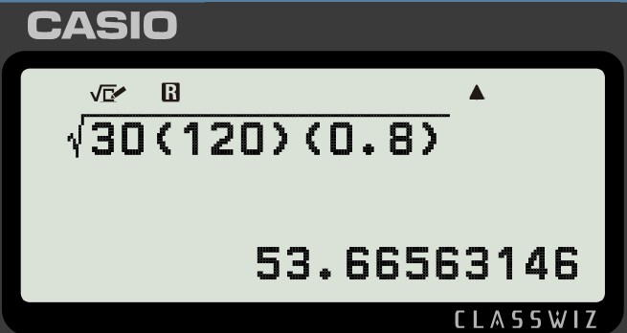
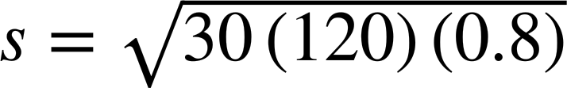
Uses of formulas
A police officer measures these skid marks at the scene of an accident on a concrete road on a dry day.
120 feet
By substituting into the formula they can calculate how fast the car was travelling.
d = 120
s = 53.7 mph (to 1 d.p.)
f = 0.8

Slide 19
Uses of formulas
A police officer measures these skid marks at the scene of an accident on a concrete road on a wet day.
97 feet
Was the car exceeding the 30 mph speed limit?
The coefficient of friction on a wet concrete surface is 0.4

Slide 20
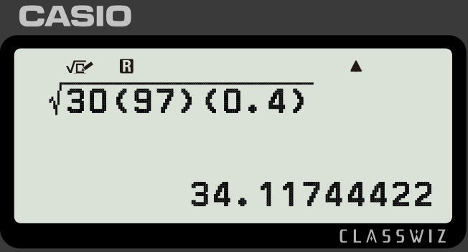
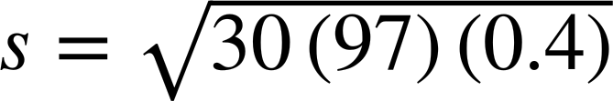
Uses of formulas
A police officer measures these skid marks at the scene of an accident on a concrete road on a wet day.
97 feet
Was the car exceeding the 30 mph speed limit?
d = 97
s = 34.1 mph (to 1 d.p.)
f = 0.4
Yes, the car was exceeding the 30 mph limit.

Slide 21
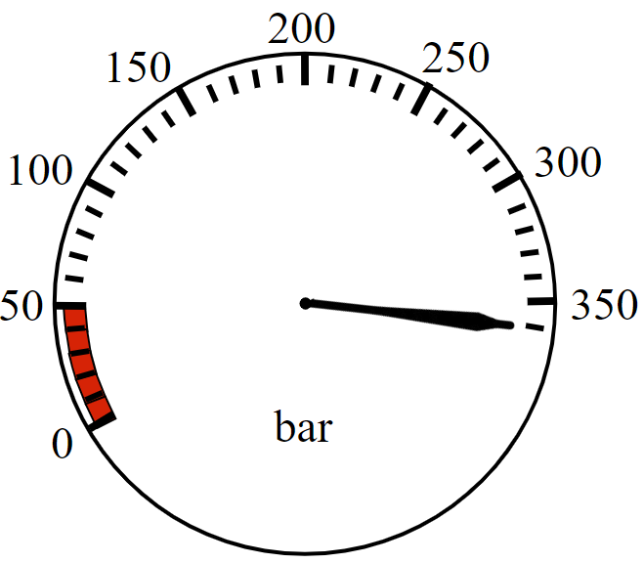
Uses of formulas
1) a) A firefighter enters the building with their gauge reading like so. At what bar should they turn around and start exiting?
b) A firefighter has an estimated turn-around pressure of 160 bar. How many bar of pressure did they have when they entered?

Slide 22
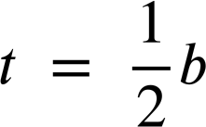
Uses of formulas
1) c) What is the difference in turn-around pressures between entering with 240 bar and entering with 300 bar?
d) Why do you think the formula includes + 30 instead of just
being ?

Slide 23
Uses of formulas
2) a) You are a police officer investigating an accident. Use the formula to calculate the speed of this car on a dry concrete surface (f = 0.8)
197 feet
b) If a car were travelling 70 mph on a wet concrete surface (f = 0.4) how long would you expect the skid mark to be?

Slide 24
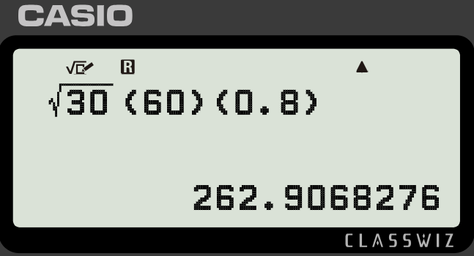
Uses of formulas
2) c) Lucas has used the formula incorrectly to calculate the speed of a car with a skid mark of 60 feet on a dry concrete surface (f = 0.8). Explain his error to him and correct his work.
My calculator tells me their speed was 262.9 mph

Slide 25
Uses of formulas
2) d) A police officer investigating an accident in a 20 mph zone with a dry concrete surface (f = 0.8) declares, “The length of the marks were 20 feet to the nearest 10 feet”.
Explain why they cannot round like this when investigating this accident.

Slide 26

Uses of formulas
1) a) A firefighter enters the building with their gauge reading like so. At what bar should they turn around and start exiting?
They should turn around at 210 bar

Slide 27
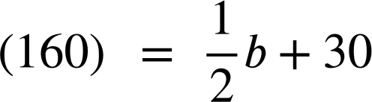
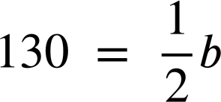
Uses of formulas
1) b) A firefighter has an estimated turn-around pressure of 160 bar. How many bar of pressure did they have when they entered?
They entered with 260 bar of pressure.
260 = b

Slide 28
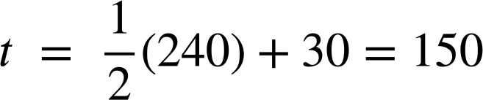
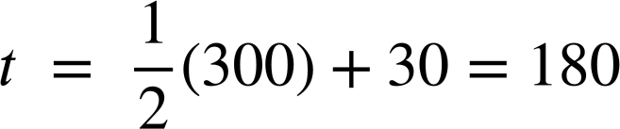
Uses of formulas
1) c) What is the difference in turn-around pressures between entering with 240 bar and entering with 300 bar?
240 bar of pressure:
300 bar of pressure:
180 − 150 = 30
The difference in turn-around is 30 bar of pressure.

Slide 29
Uses of formulas
1) d) Why do you think the formula includes + 30 instead of just being ?
You might have said, “If the formula were firefighters would turn around after using exactly half their air.
If they exerted more effort exiting (e.g. if they were carrying someone) they would not have sufficient air to get out safely.
Having +30 in the formula gives them a small safety buffer”.

Slide 30
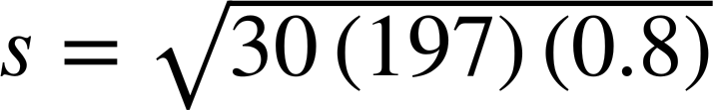
Uses of formulas
2) a) You are a police officer investigating an accident. Use the formula to calculate the speed of this car on a dry concrete surface (f = 0.8)
197 feet
d = 197
f = 0.8
s = 68.8 mph (to 1 d.p.)

Slide 31
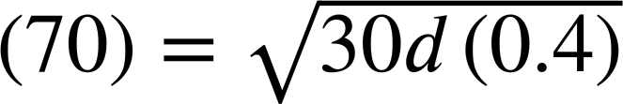

Uses of formulas
2) b) If a car were travelling 70 mph on a wet concrete surface (f = 0.4) how long would you expect the skid mark to be?
4900 = 12d
d = 408.3 feet (to 1 d.p.)

Slide 32
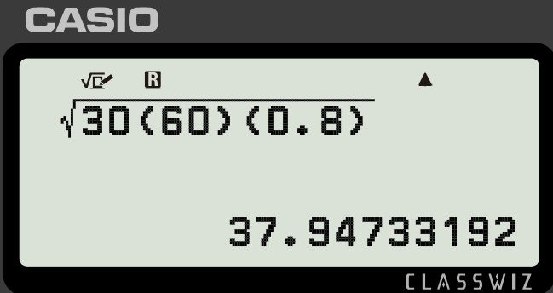
Uses of formulas
2) c) Lucas has used the formula incorrectly to calculate the speed of a car with a skid mark of 60 feet on a dry concrete surface (f = 0.8). Explain his error to him and correct his work.
My calculator tells me their speed was 262.9 mph
You might have said:
“The vinculum should group the 30df ”
“The car was travelling 37.9 mph”

Slide 33
Uses of formulas
2) d) A police officer investigating an accident in a 20 mph zone with a dry concrete surface (f = 0.8) declares, “The length of the marks were 20 feet to the nearest 10 feet”.
Explain why they cannot round like this when investigating this accident.
You might have said: “By rounding to the nearest 10 the actual length falls in the bounds 15 ≤ d < 25 which makes the bounds for the speed…”
19.0 ≤ s < 24.5
“We cannot prove whether this driver was obeying the speed limit or not.”

Slide 34
Emergency response worker
Uses of formulas
Uses of data

Slide 35
Uses of data
Data forms an essential part of operating successfully for emergency service workers.
Data enables emergency services to adequately plan to meet the needs of the public.

Slide 36
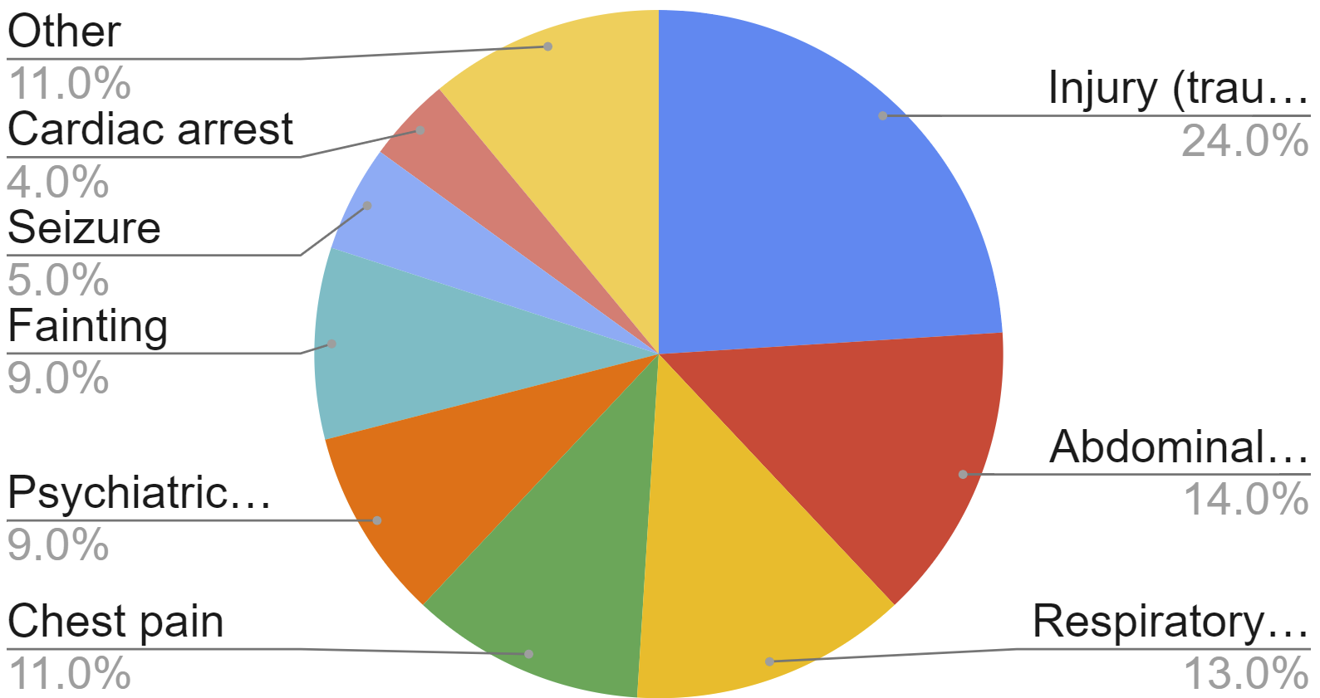
Uses of data
An ambulance station records data on the reason for call-outs for its paramedics for a quarter.
This data tells them that they need to stock their ambulances with larger amounts of medical supplies to treat:
Injury (trauma)
Abdominal pain
Respiratory distress

Slide 37
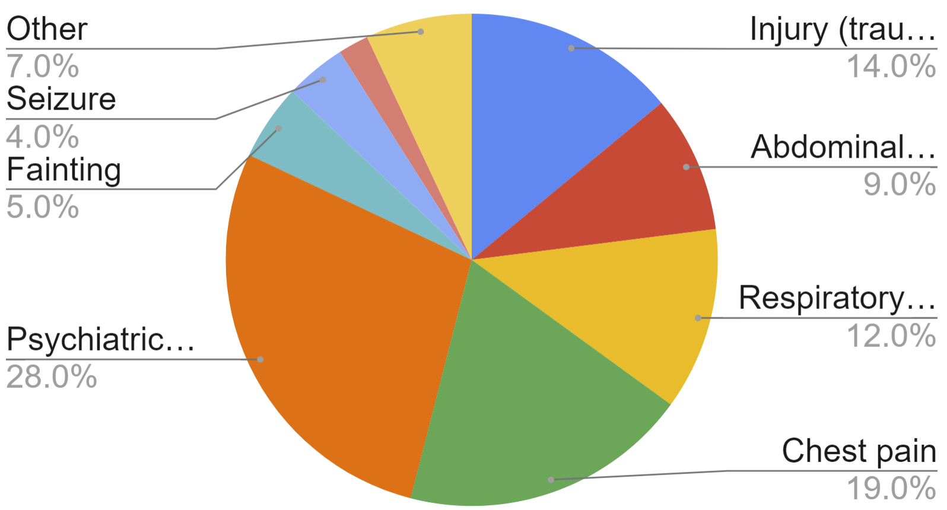
Uses of data
A different ambulance station in a city centre records data.
Psychiatric (disorder) and chest pain.
To what illnesses should they dedicate the most training time for their emergency responders?

Slide 38
Uses of data
If you ever call for an ambulance, you get through to an emergency responder whose job it is to assess and prioritise your need.
For illnesses which have an immediate threat to life the emergency services set target response times.

Slide 39
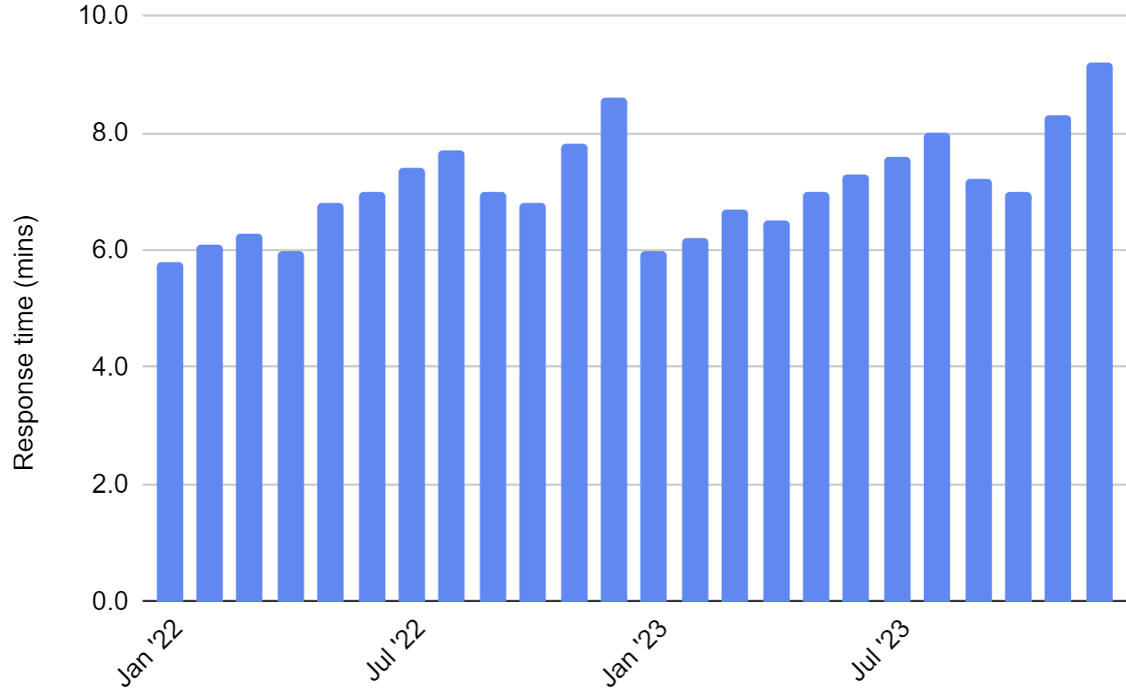
Uses of data
An ambulance station records the average time it takes for them to reach every single call for cardiac arrest over two years.
Target response time: 7 minutes
What patterns do you see in these response times?

Slide 40
Uses of data
An ambulance station records the average time it takes for them to reach every single call for cardiac arrest over two years.
They hit their target response time in the mid-late winter and early spring months.
They miss their target response time in the summer months and in Nov/Dec.

Slide 41
Uses of data
This sort of analysis might lead to changes in practice, staff numbers or shift patterns, in order to ensure 7 minutes is more consistently hit.
They hit their target response time in the mid-late winter and early spring months.
They miss their target response time in the summer months and in Nov/Dec.

Slide 42
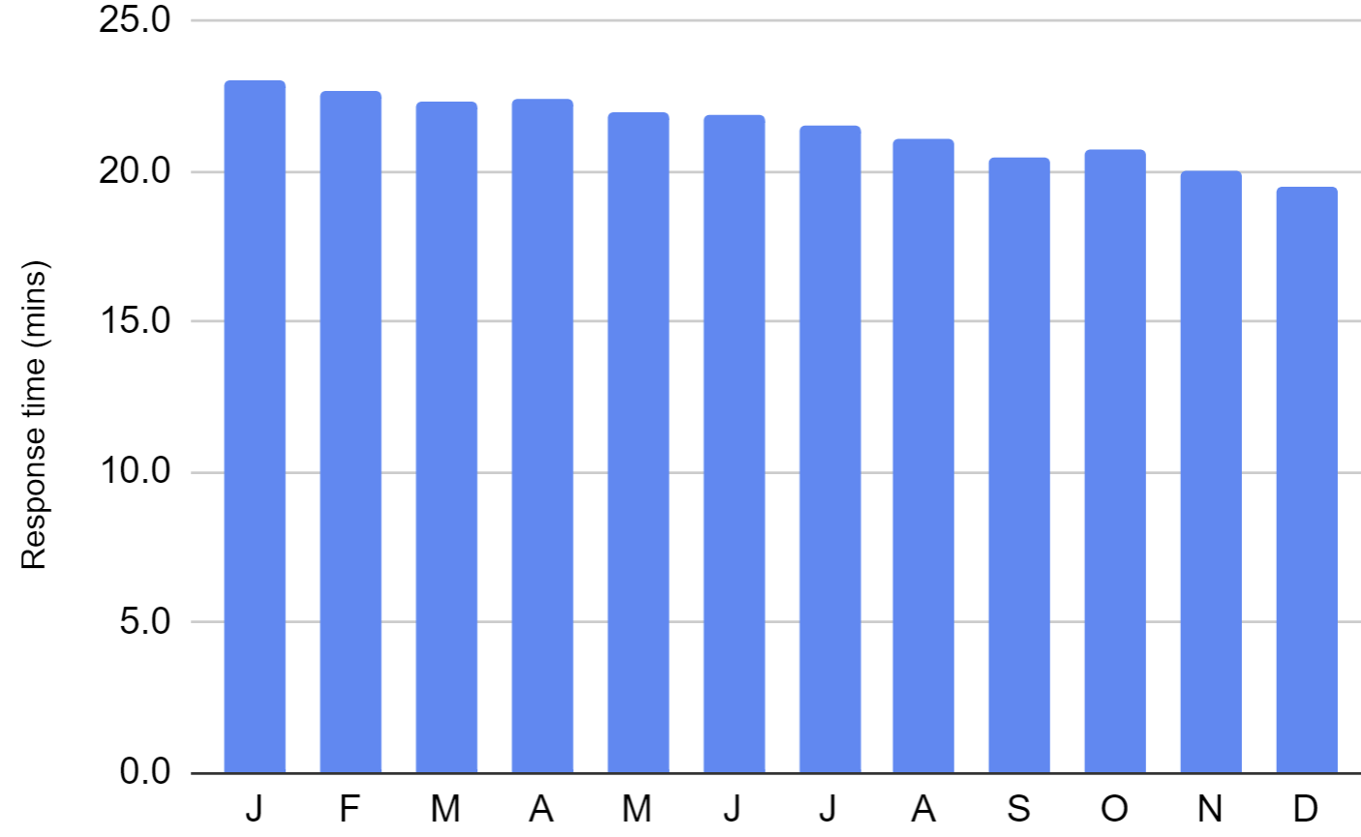
Uses of data
An ambulance station records this data on the average time it takes them to attend call-outs for strokes (a category two threat to life).
Target response time: 18 minutes
What can you conclude from this data?

Slide 43
Uses of data
An ambulance station records this data on the average time it takes them to attend call-outs for strokes (a category two threat to life).
This station is not yet meeting its target response times but, the trend is improving. If the trend continues we can expect them to hit 18 minutes next year.

Slide 44
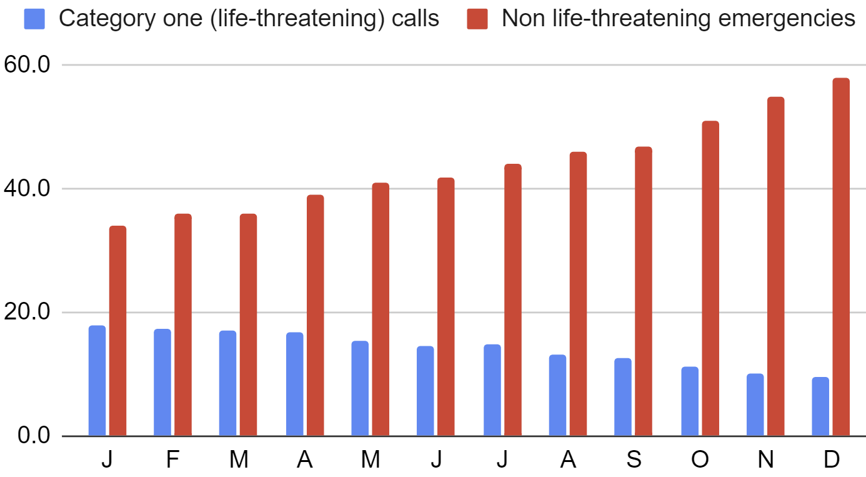
Uses of data
1) An ambulance station records their average response times to emergency calls one year. What patterns do you see in this data?

Slide 45
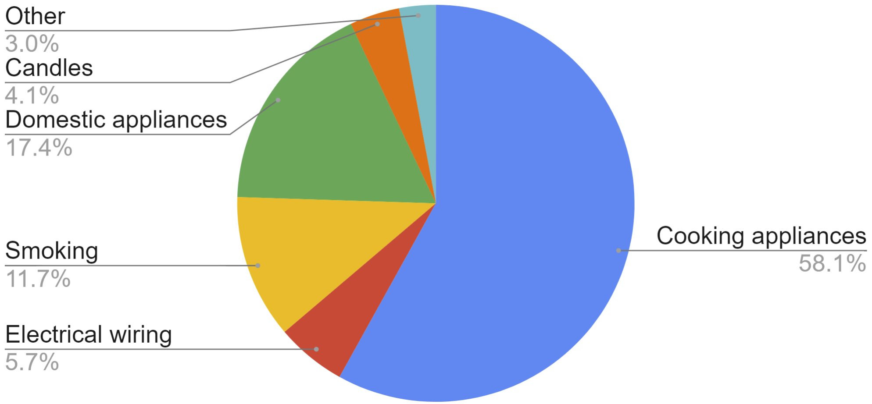
Uses of data
2) A regional fire service records the reasons for house fires over a year and produces this chart. What advice would you give this fire service? Write at least three sentences.

Slide 46
Uses of data
1) An ambulance station records their average response times to emergency calls one year. What patterns do you see in this data?
You might have said, “Response times to life-threatening calls are improving whereas non life-threatening response times are getting worse.”

Slide 47
Uses of data
2) A regional fire service records the reasons for house fires over a year and produces this chart. What advice would you give this fire service? Write at least three sentences.

Slide 48
Uses of data
2)
You might have said:
The fire engines need to be adequately stocked with the correct gear to tackle cooking appliance fires as these account for more than half of the house fires.
Appliances (cooking and domestic) account for around three quarters of fires. This fire service might consider extra training for firefighters on these types of fires. Additionally they might consider a public campaign to help raise awareness of what causes these types of fires and what can be done to prevent them.

Slide 49
Emergency response worker
Maths is used in different ways by emergency response workers.
Firefighters use a formula to calculate their turn-around time before entering a burning building. Police officers use a formula to calculate the speed of cars that were involved in accidents.
All emergency services use data to track their performance over time and to make sure they are prepared to meet the demands placed upon them by the general public.

Slide 50

© Oak National Academy 2024.
Produced in partnership with Mathematics in Education and Industry.
Licensed on the Open Government Licence v3.0, except where otherwise stated. See Oak terms and conditions.

